Slide 1

Identifying problems in the SC and First Analysis
18 March 2024
^{Value Chain Rebels}

Slide 2
Methodology
Tracking + Medium (Week 1)
Identifying the Problem (Week 1)
Scope the Problem (Week 2)
Re-framing the problem (Week 3)
Practicalities (Week 3)
Feedback and Input (Week 4)

Slide 3
Identifying the Problem (Week 1)
Building an Open Consortium of Experts
Medium of Looking: News and Active looking, Monitoring Trends and Changes (News Alerts)
Key Problem Statement (SMART) (Hypothesis)
Which Supply Chain is involved? Is there a company involved?
What is the product? (If there is a company)
What is in the product? (to map the chain)
What is the expected outcome of the project?(What do we want to achieve?)
This could also be finessed using the 5 Whys

Slide 4
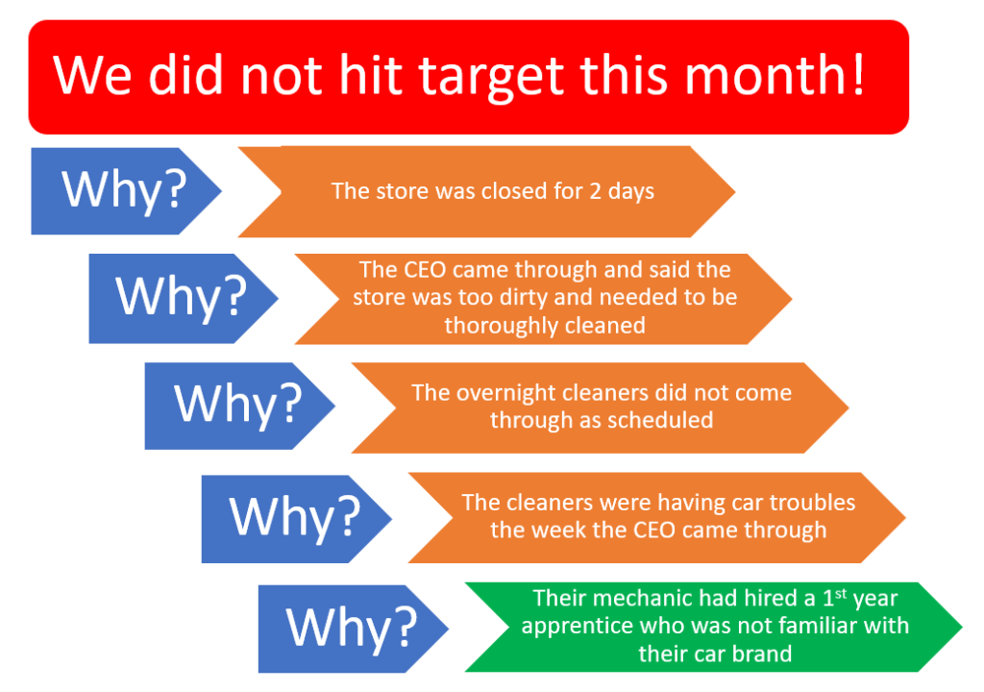
5 Whys
Source: The Data School

Slide 5
Confronting the Problem
1. State the problem 2. State the facts, brutally Restate the facts, honestly and brutally, without adding any assumptions, proposed solutions, or unnecessary details. 3. Outline the scope of the problem Be sure to describe the full scope of the problem. Clearly identify symptoms versus root causes 4. Ask more questions

Slide 6
Scope the Problem (Week 2)
Does it have a SC Component? Which SC components factor in?
What is the extent of the problem (area)?
Who are the stakeholders? PESTEL Analysis
What are the causes effects and impacts?
How many are affected?
How deep does the problem go?
Have any past preventative measures been taken?
Risk analysis (Reputational, financial, facilities, emotional, physical)

Slide 7
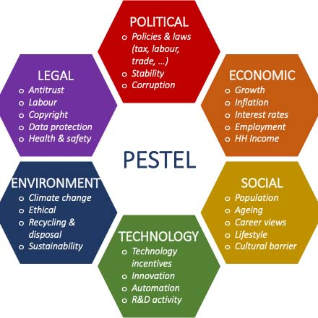
PESTEL Analysis
Source: SpringWorks

Slide 8
Re-framing the Problem (Macro) (Week 3)
Leave the blame behind
Focus on the system
What is the reality?
What are the Objectives?
Refection and Review

Slide 9
Practicalities (Week 3)
What are the parameters that will help us decide on this problem?
What resources are required and do we have them?
Can this be resolved using student and multistakeholder action?
Is this possible within 6 months?
Can we take a practical approach?
Present the case to the Open consortia and let them review

Slide 10
Feedback and Input
Open Consortia shares feedback
Reframe the problem based on feedback
Make a Decision!!! (Voting?)
Next Steps:
Find a company to work with or approach the one from the analysis
Start the Value Chain and Stakeholder mapping using AI tool (Product)

Slide 11
Other methods
Feedback and Input – General Consortia and Open consortia
Monitoring Trends and Changes

Slide 12
Timeline- Open and Close Consortia
Presenting the case- Defined SC problem
Timeline- First line of process
Key Question
Company name associated (involved in the issues)
Product
Dissect the product looking into the ingredients

Slide 13
Process
Timeline
First analysis and hypothesis

